Slide 1

CS Responsibility: Algorithmic Bias
Reports from subcontracted workers for Google collecting data for facial recognition tech
Asked to target people with “darker skin tones”, people more likely to be enticed by $5 gift card
“I feel like they wanted us to prey on the weak”
Connected to larger issue: algorithmic bias
Search engines
Criminal risk assessment
Facial recognition
Sources:
https://towardsdatascience.com/mitigating-algorithmic-bias-in-predictive-justice-ux-design-principles-for-ai-fairness-machine-learning-d2227ce28099
https://www.theguardian.com/technology/2019/oct/03/google-data-harvesting-facial-recognition-people-of-color
https://www.newscientist.com/article/2166207-discriminating-algorithms-5-times-ai-showed-prejudice/
https://www.wired.com/story/the-real-reason-tech-struggles-with-algorithmic-bias/
https://towardsdatascience.com/mitigating-algorithmic-bias-in-predictive-justice-ux-design-principles-for-ai-fairness-machine-learning-d2227ce28099
https://9to5google.com/2019/10/04/google-wants-tiktok-competitor/

Slide 2
More on algorithmic bias
Disparate impact vs. disparate treatment
Search engines: jobs on Google
Image search for “CEO”: 11% female, vs. 27% of actual CEOs in U.S.
High-income jobs shown to men much more often than to women
Criminal Risk Assessment: COMPAS model by Northpointe
High-risk, didn’t offend: 44.9% Black, 23.5% White
Low-risk, did offend: 28% black, 47.7% white
Facial recognition: Study in 2018 on three of the biggest gender-recognition AI’s
99% accuracy on white men, 35% accuracy on dark-skinned women
Back to Google: Attempted to resolve racist facial recognition technology…by being racist?
How should algorithmic bias be addressed?

Slide 3
Important Course Reminders
Please don’t address TAs or HTAs outside of TA/Conceptual Hours, Sections, HTA Hours, or e-mail. TAs and HTAs are students, just as you, and their personal time should be dedicated to their own coursework.
Starting early is essential for the next projects of the course. The difficulty grows exponentially. We strongly suggest taking advantage of conceptual hours, TA hours, and Piazza.
Confused by a lecture topic? Come to conceptual hours! Stuck on part of DoodleJump? Come to conceptual hours! Want to discuss containment with others? Come to conceptual hours!
The cutoff doesn’t mean that you won’t be seen in hours, it just means that there is a chance that you won’t be seen!
Section and labs are mandatory! Not going to sections and labs will affect your grade in the course. You can work on labs previously and get checked off at the beginning of your lab, but you can’t skip it entirely.
We know that TA hours lines have been getting longer, and that this course is difficult; however, always be mindful about the way that you address TAs, they are here to help and they deserve to be treated with respect at all times.

Slide 4

Lecture 14
Recursion

Slide 5


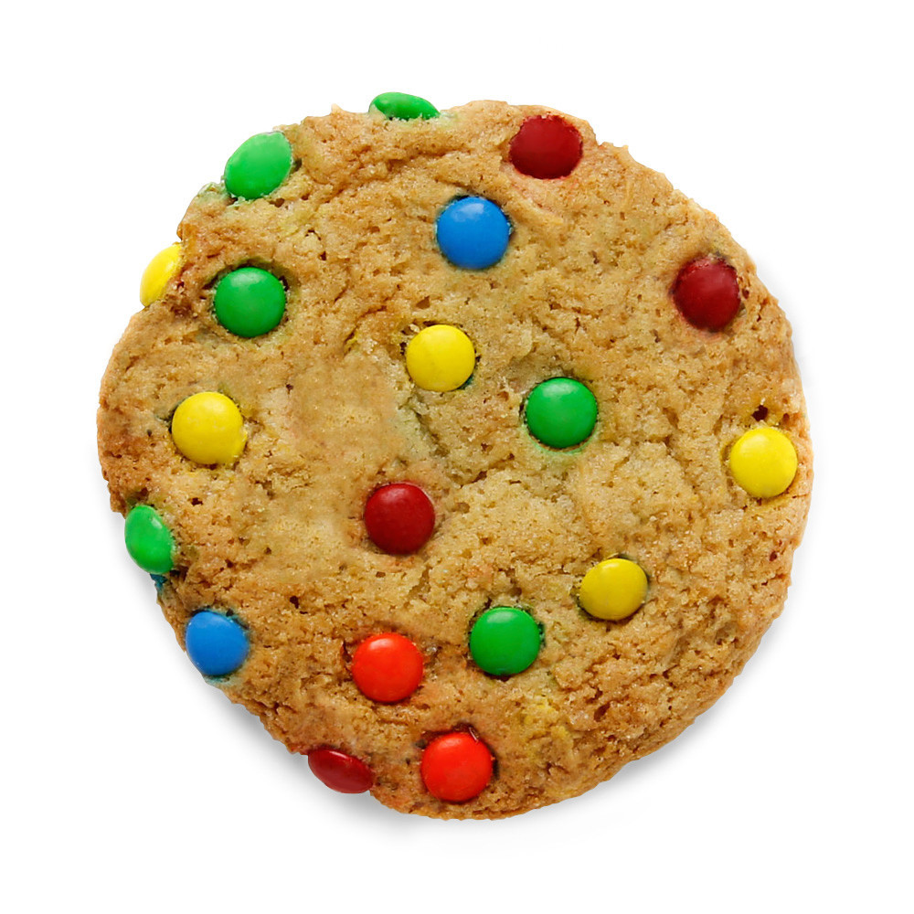

Jim, Pam, Dwight & Michael Like Cookies (1/2)
They would each like to have one of these cookies:
How many ways can they distribute the cookies amongst themselves?
the first character who picks has four choices
three choices are left for the second character
two choices left for the third character
the last character has to take what remains (poor Michael!)

Slide 6
Jim, Pam Dwight & Michael Like Cookies (2/2)
Thus we have 24 different ways the characters can choose cookies (4! = 4 x 3 x 2 x 1 = 24)
What if we wanted to solve this problem for all of Michael’s enemies– all of the employees at Dunder Mifflin?

Slide 7
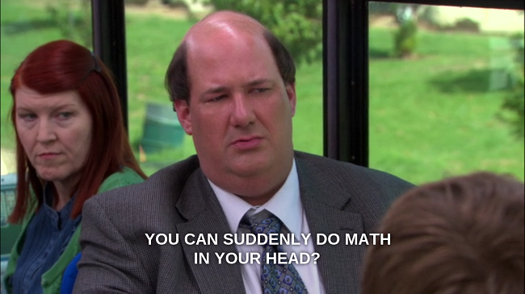
Factorial Function
Model this problem mathematically:
factorial (n!) calculates the total number of unique permutations, or the number of different ways to arrange/order n items
Small examples:
1! = 1 2! = 2*1 = 2
3! = 3*2*1 = 6 4! = 4*3*2*1 = 24
5! = 5*4*3*2*1 = 120
Iterative definition: n! = n * (n-1) * (n-2) * … * 1
Recursive definition: n! = n * (n-1)! for n >= 1 and 0! = 1

Slide 8

Recursion (1/2)
Models problems that are self-similar
decompose a whole task into smaller, similar sub-tasks
each subtask can be solved by applying the same technique
Whole task solved by combining solutions to sub-tasks
special form of divide and conquer at every level

Slide 9
Recursion (2/2)
Task is defined in terms of itself
in Java, recursion is modeled by method that calls itself, but each time with simpler case of the problem, hence the recursion will “bottom out” with a base case eventually
base case is a case simple enough to be solved directly, without recursion; otherwise infinite recursion and StackOverflowError
what is the base case of the factorial problem?
Java will bookkeep each invocation of the same method just as it does for nested methods that differ, so there is no confusion
usually you combine the results from the separate invocations

Slide 10
Factorial Function Recursively (1/2)
Recursive factorial algorithm
the factorial function is not defined for negative numbers
the first conditional checks for this precondition
it is good practice to document and test preconditions (see code example)
number of times method is called is the depth of recursion (1 for 0!)
what is depth of (4!)?
public class RecursiveMath{
//instance variables, other code elided
public int factorial (int num) {
if (num < 0){
System.out.println(“Input must be >= 0”);
return -1; // return -1 for invalid input
}
int result = 0;
if (num == 0){ // base case: 0! = 1
result = 1;
}
else{ //general case
result = num * this.factorial(num - 1);
}
return result;
}
}

Slide 11
Factorial Function Recursively (2/2)
4! = factorial(4)
factorial(4)
= 4 * 3!
= 4 * 3 * 2!
= 4 * 3 * 2 * 1!
= 4 * 3 * 2 * 1 * 0!
= 24
4
*
factorial(3)
3
*
factorial(2)
2
*
factorial(1)
1
*
factorial(0)
1

Slide 12
TopHat Question
Given the following non-practical code:
public class RecursiveMath {
public int recursiveAddition(int n) {
if (n<=1) {
return 1;
} else {
return recursiveAddition(n-1);
}
}
}
What is the output of this.recursiveAddition(4)?
1
9
10
StackOverflowError

Slide 13
TopHat Question
Given the following code:
public class RecursiveMath {
public int funkyFactorial(int n) {
if (n == 0) {
return 1;
} else {
return n * this.funkyFactorial(n-2);
}
}
}
What is the output of this.funkyFactorial(5)?
1
5
15
StackOverflowError

Slide 14
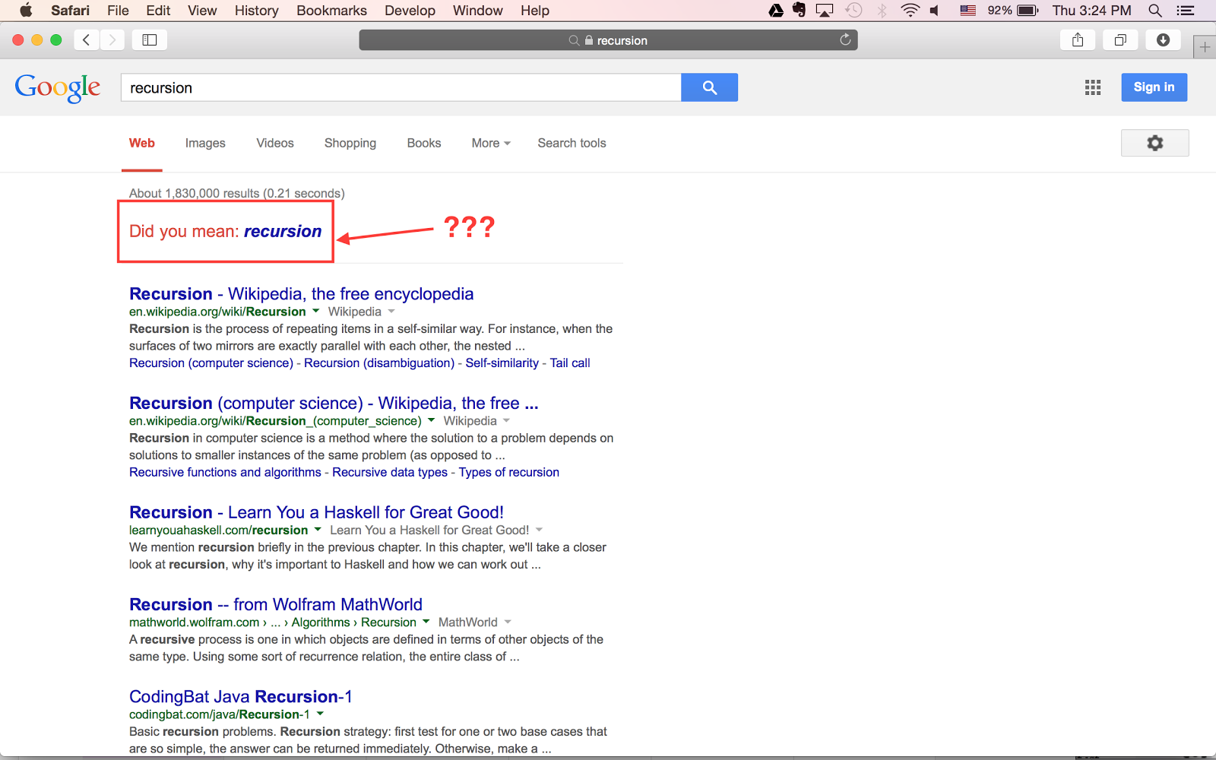
If you want to know more about recursion...

Slide 15
Turtles in Recursion – from Wikipedia
The following anecdote is told of William James. After a lecture on cosmology and the structure of the solar system, James was accosted by a little old lady.
"Your theory that the sun is the centre of the solar system, and the earth is a ball which rotates around it has a very convincing ring to it, Mr. James, but it's wrong. I've got a better theory," said the little old lady.
"And what is that, madam?" inquired James politely.
"That we live on a crust of earth which is on the back of a giant turtle."
Not wishing to demolish this absurd little theory by bringing to bear the masses of scientific evidence he had at his command, James decided to gently dissuade his opponent by making her see some of the inadequacies of her position.
"If your theory is correct, madam," he asked, "what does this turtle stand on?"
"You're a very clever man, Mr. James, and that's a very good question," replied the little old lady, "but I have an answer to it. And it's this: The first turtle stands on the back of a second, far larger, turtle, who stands directly under him."
"But what does this second turtle stand on?" persisted James patiently.
To this, the little old lady crowed triumphantly,
"It's no use, Mr. James — it's turtles all the way down."
— J. R. Ross, Constraints on Variables in Syntax 1967
William James (January 11, 1842 – August 26, 1910)
Earliest psychologist
— it's turtles all the way down

Slide 16
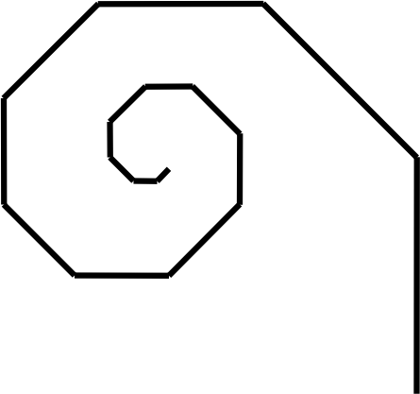
Call Out the Turtles
Benoit Mandelbrot developed Fractals, a mathematical branch whose principle characteristic is self-similarity at any scale, one of the characteristics of recursions. Fractals are common in nature (botany, lungs, blood vessels, kidneys…), cosmology, antennas, Z_{n+1} = Z_{n}² +C in the complex plane (x, i) where i = sqrt(-1)…
check out:
https://www.youtube.com/watch?v=2JUAojvFpCohttp://matek.hu/xaos/doku.php
http://projects.delimited.io/experiments/dragon-curves/dragons-single.html
https://www.youtube.com/watch?v=aSg2Db3jF_4
http://bl.ocks.org/syntagmatic/3736720
https://www.youtube.com/watch?v=4LQvjSf6SSw
Some simpler, non-fractal, but still self-similar shapes composed of smaller, simpler copies of some pattern are simple spirals, trees, and snowflakes
We can draw these using Turtle graphics
iteratively: Start at a particular point, facing in a chosen direction (here up). Draw successively shorter lines, each line at a given angle to the previous one
recursively: Start at a particular point, in a given direction. Draw a line of passed-in length, turn the passed-in angle, decrement length and call spiral recursively

Slide 17
Designing Spiral Class (1/2)
Spiral class defines single draw method
turtle functions as pen to draw spiral, so class needs reference to turtle instance
Constructor’s parameters to control its properties:
position at which spiral starts is turtle’s position
length of spiral’s starting side
angle between successive line segments
amount to change length of spiral’s side at each step
Note: this info is passed to each invocation of recursive method, so next method call depends on previous one

Slide 18
Designing Spiral Class (2/2)
public class Spiral {
private Turtle _turtle;
private double _angle;
private int _lengthDecrement;
// passing in parameters to set the properties of the spiral
public Spiral(Turtle myTurtle, double myAngle, int myLengthDecrement) {
_turtle = myTurtle;
_angle = myAngle;
_lengthDecrement = 1; // default, handles bad parameters
if (myLengthDecrement > 0){
_lengthDecrement = myLengthDecrement;
}
// draw method defined soon...
}
}

Slide 19
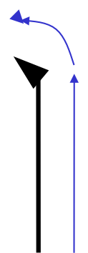
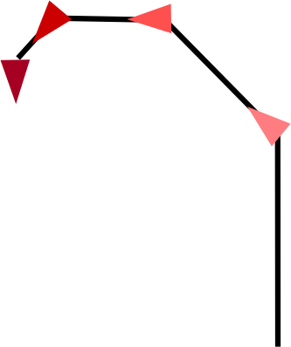
Drawing Spiral
First Step: Move turtle forward to draw line and turn some degrees. What’s next?
Draw smaller line and turn! Then another, and another…

Slide 20
Sending Recursive Messages (1/2)
draw method uses turtle to trace spiral
How does draw method divide up work?
draw first side of spiral
then draw smaller spiral (this is where we implement recursion)
public void draw(int sideLen){
// general case: move sideLen, turn
// angle and draw smaller spiral
_turtle.forward(sideLen);
_turtle.left(_angle);
this.draw(sideLen - _lengthDecrement);
}

Slide 21
Sending Recursive Messages (2/2)
public void draw(int sideLen){
// base case: spiral too small to see
if (sideLen <= 3) {
return;
}
// general case: move sideLen, turn
// angle and draw smaller spiral
_turtle.forward(sideLen);
_turtle.left(_angle);
this.draw(sideLen - _lengthDecrement);
}
What is the base case?
when spiral is too small to see, conditional statement stops method so no more recursive calls are made
since side length must approach zero to reach the base case of the recursion, the draw method is called recursively, passing in a smaller side length each time

Slide 22
Recursive Methods
We are used to seeing a method call other methods, but now we see a method calling itself
Method must handle successively smaller versions of original task

Slide 23
Method’s Variable(s)
As with separate methods, each invocation of the method has its own copy of parameters and local variables, and shares access to instance variables
Parameters let method invocations (i.e., successive recursive calls) “communicate” with, or pass info between, each other
Java’s record of current place in code and current values of parameters and local variables is called the activation record
with recursion, multiple activations of a method may exist at once
at base case, as many exist as depth of recursion
each activation of a method is stored on the activation stack (you’ll learn about stacks soon)

Slide 24
Spiral Activation
draw(int sideLen)
Initial value of sideLen: 25
Length decrement: 11
activation of
draw method
draw Activation
int sideLen = 25
activation of
draw method
draw Activation
int sideLen = 14
recursion unwinds
after reaching
base case
activation of
draw method
draw Activation
int sideLen = 3

Slide 25
TopHat Question
Given the following code for the Collatz conjecture:
public class RecursiveMath{
private int _count;
//constructor elided. _count gets 0, it records
//number of calls on collatzCounter
public int collatzCounter(int n) {
_count += 1;
if (n == 1) { //base case
return 1;
} else {
if (n % 2 == 0) { //if n is even
return collatzCounter(n / 2);
} else {
return collatzCounter(3 * n + 1);
}
}
}
}
What is the value of _count after calling collatzCounter(5)?
A. 4
B. 5
C. 6
D. StackOverflowError
“The Collatz conjecture is a conjecture in mathematics named after Lothar Collatz. It concerns a sequence defined as follows: start with any positive integer n. Then each term is obtained from the previous term as follows: if the previous term is even, the next term is one half the previous term. Otherwise, the next term is 3 times the previous term plus 1. The conjecture is that no matter what value of n, the sequence will always reach 1.” (From Wikipedia)

Slide 26
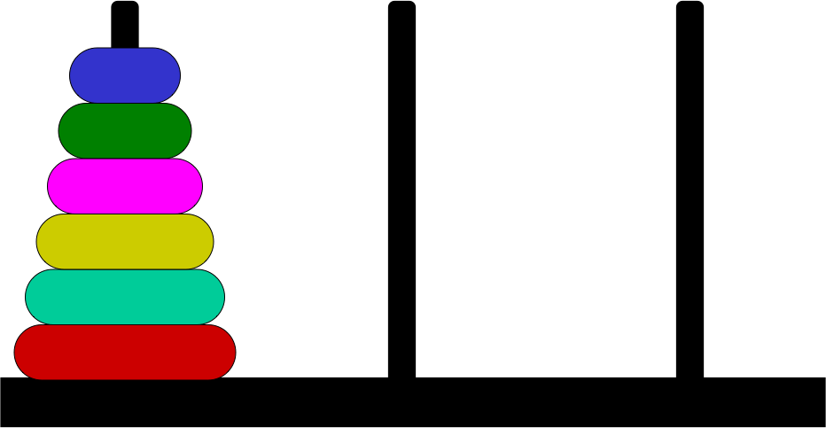
Towers of Hanoi (1/4)
Game invented by French mathematician Edouard Lucas in 1883
Goal: move tower of n disks, each of a different size (in order, with smallest at top), from left-most peg to right-most peg
Rule 1: no disk can be placed on top of a smaller disk to win
Rule 2: only one disk can be moved at a time

Slide 27
One Disk Solution
Move to target peg
Base Case

Slide 28
Two Disk Solution
Use 1-disk solution
Use 1-disk solution
Use 1-disk solution
(base case)

Slide 29
Three Disk Solution
Use 2-disk solution
Use 1-disk solution
Use 2-disk solution
(base case)

Slide 30
Pseudocode for Towers of Hanoi (1/2)
Try solving for 5 non-recursively…
One disk:
move disk to final pole
Two disks:
use one disk solution to move top disk to intermediate pole
use one disk solution to move bottom disk to final pole
use one disk solution to move top disk to final pole
Three disks:
use two disk solution to move top disks to intermediate pole
use one disk solution to move bottom disk to final pole
use two disk solution to move top disks to final pole

Slide 31
Pseudocode for Towers of Hanoi (2/2)
In general (for n disks)
use n-1 disk solution to move top disks to intermediate pole
use one disk solution to move bottom disk to final pole
use n-1 disk solution to move top disks to final pole
Note: can have multiple recursive calls in a method

Slide 32
Lower level pseudocode
//n is number of disks, src is starting pole,
//dst is finishing pole
public void hanoi(int n, Pole src, Pole dst, Pole other){
if (n==1) {
this.move(src, dst);
}
else {
this.hanoi(n-1, src, other, dst);
this.move(src, dst);
this.hanoi(n-1, other, dst, src);
}
}
public void move(Pole src, Pole dst){
//take the top disk on the pole src and make
//it the top disk on the pole dst
}
That’s it! otherPole and move are fairly simple methods, so this is not much code.
But try hand simulating this when n is greater than 4. Whoo boy, it is tedious (but not hard!)
Iterative solution far more complex, and much harder to understand

Slide 33
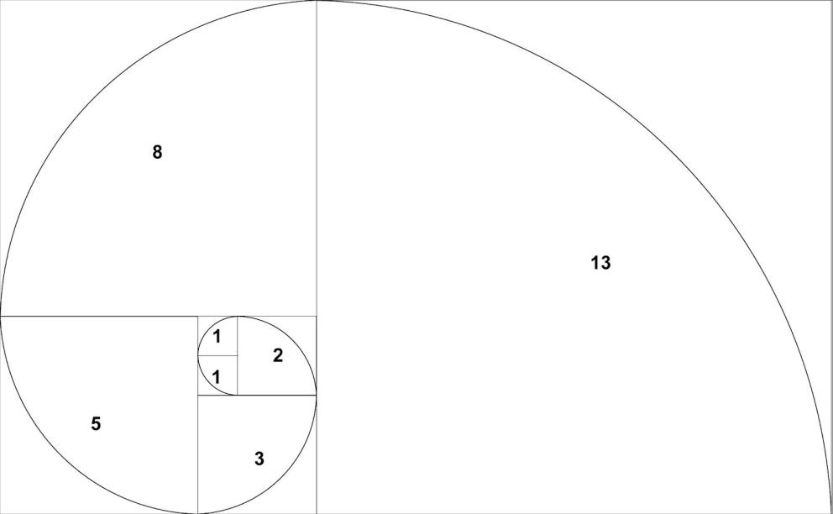
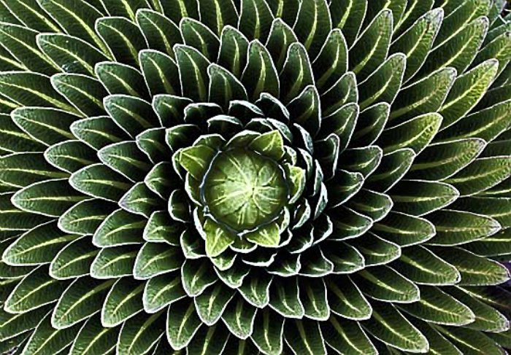
Fibonacci Sequence (1/2)
1, 1, 2, 3, 5, 8, 13, 21…
Each number is calculated by adding the two previous numbers
F_{n} = F_{n-1} + F_{n-2}
Fun application of fibonacci sequence: https://www.npr.org/2018/08/10/637470699/let-this-percussionist-blow-your-mind-with-the-fibonacci-sequence

Slide 34
Fibonacci Sequence (2/2)
What is the base case?
there are two: n=0 and n=1
Otherwise, add two previous values of sequence together
this is also two recursive calls!
// returns n^{th} value of Fibonacci sequence
public int fib(int n){
if (n < 0) {
System.out.println(“input must be >= 0”);
return -1;
}
// base cases: n is 0 or 1
if (n == 0 || n == 1) {
return 1;
}
// general case: add previous two values
// using two recursive calls
return fib(n-1) + fib(n-2);
}

Slide 35
TopHat Question
Given the following code:
public int fib(int n){
//error check
if (n < 0) {
return -1;
}
//base case
if (n == 0 || n == 1) {
return 1;
}
return fib(n-1) + fib(n-2);
}
What number would be returned if you excluded n == 1 from the base case and called fib(2)?
A. 5
B. 3
C. 2
D. 1

Slide 36
Loops vs. Recursion (1/2)
Spiral uses simple form of recursion
each sub-task only calls on one other sub-task
this form can be used for the same computational tasks as iteration
loops (iteration) and simple recursion are computationally equivalent in the sense of producing the same result, if suitably coded (not necessarily the same performance, though -- looping is more efficient)

Slide 37
Loops vs. Recursion (2/2)
Iteration is often more efficient in Java because recursion takes more method calls (each activation record takes up some of the computer’s memory)
Recursion is more concise and more elegant for tasks that are “naturally” self-similar (Towers of Hanoi is very difficult to solve iteratively!)
public void drawIteratively(int sideLen){
while(sideLen > 3){
_turtle.forward(sideLen);
_turtle.left(_angle);
sideLen -= _lengthDecrement;
}
}

Slide 38
Indirect Recursion
Two or more methods act recursively instead of just one
For example, methodA calls methodB which calls methodA again
Methods may be implemented in same or different classes
Can be implemented with more than two methods too

Slide 39

Recursive Binary Tree (1/2)
The tree is composed of a trunk that splits into two smaller branches that sprout in opposite directions at the same angle
Each branch then splits as the trunk did until sub-branch is deemed too small to be seen. Then it is drawn as a leaf
The user can specify the length of a tree’s main trunk, the angle at which branches sprout, and the amount by which to decrement each branch

Slide 40
Recursive Binary Tree (2/2)
Compare each left branch to its corresponding right branch
right branch is simply rotated copy
Branches are themselves smaller trees!
branches are themselves smaller trees!
branches are themselves smaller trees!
…
Our tree is self-similar and can be programmed recursively!
base case is leaf

Slide 41
Designing the Tree Class
Tree has properties that user can set:
start position (myTurtle’s built in position)
angle between branches (myBranchAngle)
amount to change branch length (myTrunkDecrement)
Tree class will define a single draw method
like Spiral, also uses a Turtle to draw
public class Tree{
private Turtle _turtle;
private double _branchAngle;
private int _trunkDecrement;
public Tree(Turtle myTurtle, double myBranchAngle,
int myTrunkDecrement){
_turtle = myTurtle;
_trunkDecrement = 1;
if(myTrunkDecrement > 0){
_trunkDecrement = myTrunkDecrement;
}
if(myBranchAngle > 0){
_branchAngle = myBranchAngle;
}
}
// draw method coming up…
}

Slide 42
Tree’s draw Method
private void draw(int trunkLen){
if (trunkLen <= 0) {
this.addLeaf();
} else {
_turtle.forward(trunkLen);
_turtle.left(_branchAngle);
this.draw(trunkLen - _trunkDecrement);
_turtle.right(2 * _branchAngle);
this.draw(trunkLen - _trunkDecrement);
_turtle.left(_branchAngle);
_turtle.back(trunkLen);
}
}
Base case: if branch size too small, add a leaf
General case:
move _turtle forward
orient _turtle left
recursively draw left branch
orient _turtle right
recursively draw right branch
reset _turtle to starting orientation
back up to prepare for next branch

Slide 43
Tree’s draw Method
private void draw(int trunkLen){
if (trunkLen <= 0) {
this.addLeaf();
} else {
_turtle.forward(trunkLen);
_turtle.left(_branchAngle);
this.draw(trunkLen - _trunkDecrement);
_turtle.right(2 * _branchAngle);
this.draw(trunkLen - _trunkDecrement);
_turtle.left(_branchAngle);
_turtle.back(trunkLen);
}
}

Slide 44
TopHat Question
Given the following code:
private void draw(int trunkLen) {
if (trunkLen <= 0) {
this.addLeaf(); // creates a leaf
// at the current location
} else {
_turtle.forward(trunkLen);
_turtle.left(_branchAngle);
this.draw(trunkLen - _trunkDecrement);
_turtle.right(2*_branchAngle);
this.draw(trunkLen - _trunkDecrement);
_turtle.left(_branchAngle);
_turtle.back(trunkLen);
}
}
What would happen if you got rid of the first call this.draw(trunkLen - _trunkDecrement)?
A. We will only draw the right half of the tree
B. We will draw a spiral that terminates in a leaf
C. Stack Overflow!
D. None of the above

Slide 45
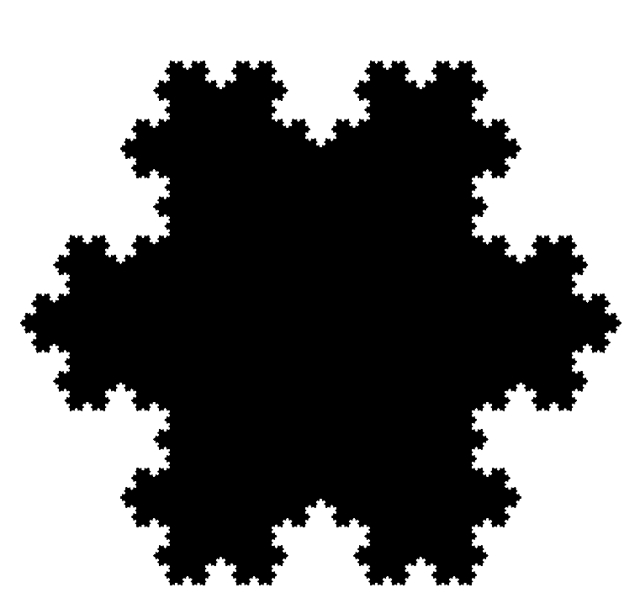
Recursive Snowflake
Invented by Swedish mathematician, Helge von Koch, in 1904; also known as Koch Island
Snowflake is created by taking an equilateral triangle and partitioning each side into three equal parts. Each side’s middle part is then replaced by another equilateral triangle (with no base) whose sides are one third as long as the original.
this process is repeated for each remaining line segment
the user can specify the length of the initial equilateral triangle’s side
“mathematical monster”: infinite length with a bounded area

Slide 46
Snowflake’s draw Method
Can draw equilateral triangle iteratively
drawSnowFlake draws the snowflake by drawing smaller, rotated triangles on each side of the triangle (compare to iterative drawTriangle)
for loop iterates 3 times
Each time, calls the drawSide helper method (defined in the next slide) and reorients _turtle to be ready for the next side
public void drawTriangle(int sideLen) {
for (int i = 0; i < 3; i++) {
_turtle.forward(sideLen);
_turtle.right(120.0);
}
}
public void drawSnowFlake(int sideLen){
for(int i = 0; i < 3; i++){
this.drawSide(sideLen);
_turtle.right(120.0);
}
}

Slide 47
Snowflake’s drawSide method
drawSide draws single side of a recursive snowflake by drawing four recursive sides
Base case: simply draw a straight side
MIN_SIDE is a constant we set indicating the smallest desired side length
General case: draw complete recursive side, then reorient for next recursive side
private void drawSide(int sideLen){
if (sideLen < MIN_SIDE){
_turtle.forward(sideLen);
}
else{
this.drawSide(Math.round(sideLen / 3));
_turtle.left(60.0);
this.drawSide(Math.round(sideLen / 3));
_turtle.right(120.0);
this.drawSide(Math.round(sideLen / 3));
_turtle.left(60.0);
this.drawSide(Math.round(sideLen / 3));
}
}

Slide 48
Hand Simulation
MIN_SIDE: 20
sideLen: 90
Call draw(90), which calls drawSide(90), which calls drawSide(30),
which calls
drawSide(10). Base case reached because 10 < MIN_SIDE
drawSide(10) returns to drawSide(30), which tells _turtle to turn left 60 degrees and then calls drawSide(10) again.
drawSide(10) returns to drawSide(30), which tells _turtle to turn right 120 and then calls drawSide(10) for a third time.
drawSide(10) returns to drawSide(30), which tells _turtle to turn left 60 degrees and then calls drawSide(10) for a fourth time.
After this call, drawSide(30) returns to drawSide(90), which reorients _turtle and calls drawSide(30) again.

Slide 49
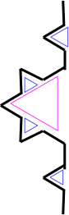
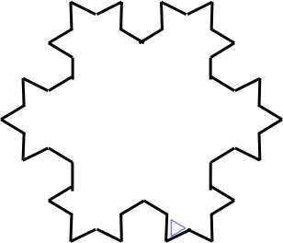
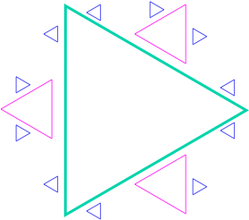
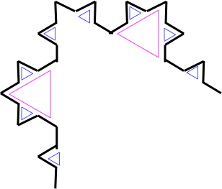
Again: Koch Snowflake Progression
colored triangles added for emphasis only

Slide 50
Summary
Recursion models problems that are self-similar, decomposing a task into smaller, similar sub-tasks.
Whole task solved by combining solutions to sub-tasks (divide and conquer)
Since every task related to recursion is defined in terms of itself, method will continue calling itself until it reaches its base case, which is simple enough to be solved directly

Slide 51
Announcements
Design discussions for DoodleJump this week!
DoodleJump due dates:
Early: 10/29, 11:59PM
On-time: 10/31, 11:59PM
Late: 11/2, 11:59PM

